Slide 1
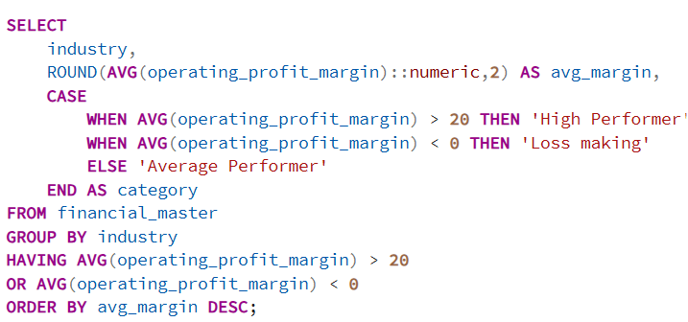
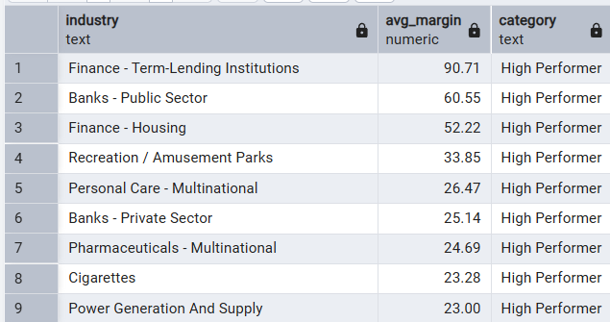
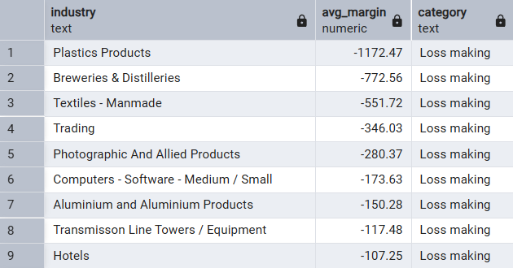
PROFITABILITY & MARGINS
Question 1: Which industries consistently maintain high profitability margins (20%+) and which industries chronically operate with negative margins?
Query
OUTPUT
Observation:
• Financial and financial-services-linked industries dominate the highest average margin group, with Finance – Term Lending Institutions and Banks showing the strongest profitability profile. • Asset-light and specialized sectors such as Pharmaceuticals (Multinational), Cigarettes, and Power Generation also maintain consistently strong margins above the benchmark. • Loss-making industries are concentrated in manufacturing-heavy and operationally intensive sectors including Plastics Products, Breweries & Distilleries, Textiles, and Trading.
Insight:
• High-margin sectors generally benefit from pricing power, capital efficiency, brand strength, or scalable business models with lower variable costs. • Financial institutions can generate stronger returns through spread economics and balance-sheet leverage when operating efficiently. • Negative-margin industries are often exposed to commodity volatility, higher fixed costs, fragmented competition, or weaker pricing control.
Recommendation:
• Prioritize deeper analysis of high-margin sectors to identify sustainable drivers versus cyclical profitability spikes. • For low-margin industries, evaluate cost structure, utilization levels, and pricing strategy before considering growth investments. • Compare margin performance with industry growth rates to identify sectors that combine profitability with expansion potential.

Slide 2
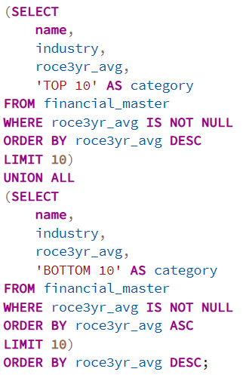
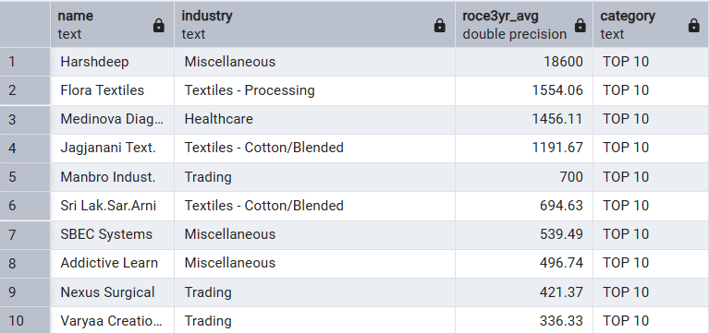
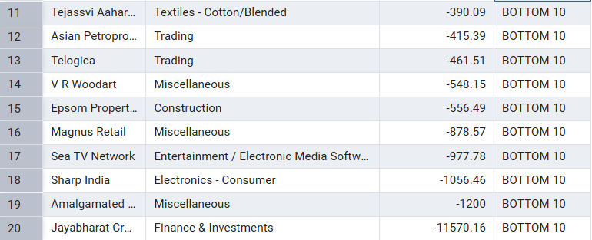
Question 2: Based on 3-year average ROCE (Return on Capital Employed), which companies rank among the top 10 and bottom 10, and which sectors dominate each group?
Query
Output
Observation:
• The highest ROCE performers are heavily concentrated in Textiles-related segments, along with representation from Healthcare, Trading, and Miscellaneous sectors. • Top-performing companies generated exceptionally high capital efficiency over the three-year period, significantly outperforming the lower-ranked group. • The bottom ROCE cohort includes Finance & Investments, Media, Construction, Consumer Electronics, and Miscellaneous sectors.
Insight:
• High ROCE concentration in selected manufacturing niches suggests efficient asset utilization and disciplined capital allocation. • Negative or weak ROCE often reflects underutilized assets, margin compression, poor investment decisions, or limited operating leverage..
Recommendation:
• Use ROCE as a screening metric alongside revenue growth and margin quality to identify durable performers. • Investigate whether high ROCE companies achieved results through sustainable operations or temporary efficiency gains.

Slide 3
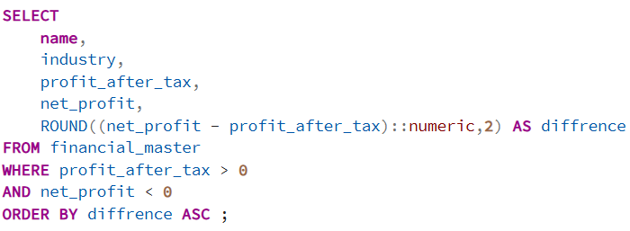
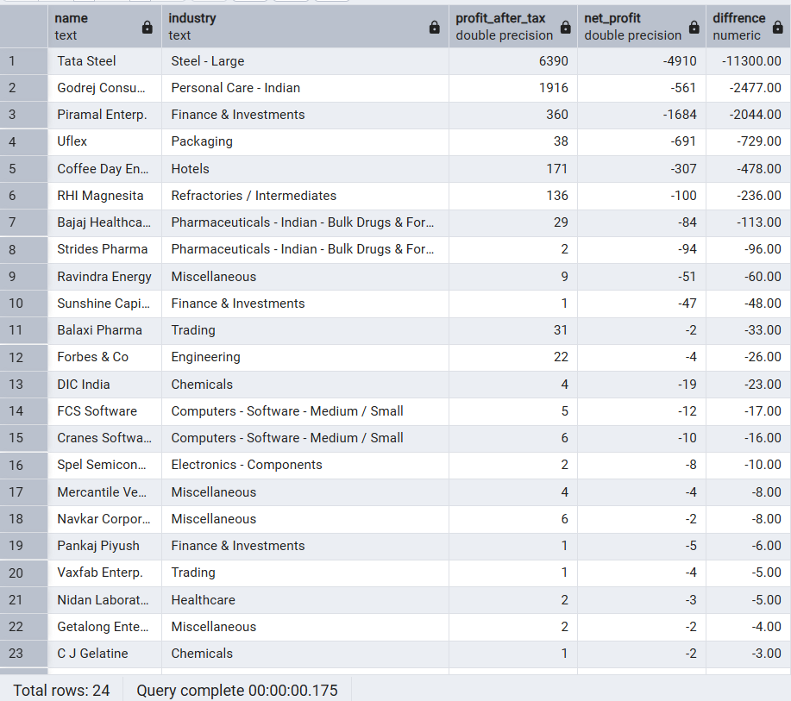
Question 3: Which companies have positive Profit After Tax (PAT) but negative Net Profit, and why does this occur?
Query
OUTPUT
Observation:
• A limited set of companies reported positive Profit After Tax while simultaneously recording negative Net Profit, indicating a mismatch between accounting layers. • The largest gap appears in companies with substantial difference values, suggesting significant non-operating or adjustment-related impacts. • Multiple sectors are represented, including Steel, Finance & Investments, Packaging, Hotels, Chemicals, and Technology-related businesses.
Insight:
• Positive PAT with negative Net Profit typically occurs due to adjustments below the PAT line such as minority interest, exceptional items, discontinued operations, consolidated losses, or accounting reclassifications. • Large differences may indicate weaker earnings quality despite reporting positive post-tax results. • Investors focusing only on PAT may overestimate underlying profitability if final attributable earnings remain negative.
Recommendation:
• Perform a reconciliation analysis between PAT and Net Profit to identify the exact adjustment drivers. • Evaluate earnings quality metrics and recurring profit generation instead of relying on headline profitability. • Flag companies with repeated PAT–Net Profit divergence for governance and financial reporting review.

